Slide 1
Small Game Programming Project
Amy Manchester

Slide 2
Aim of the game?
The aim of the game is to collect all 5 coins, while avoiding the enemy and dodging traps throughout the level.

Slide 3
Codes Used:
Destroy Laser- enemy can destroy the lasers.
Destroy Player- if player collides with the laser, kill player
DetectTry- Detect and destroy the player is caught
WayPoints- where the enemy will travel too
PickUpCoin- Collect the coins to win
MoveBackForward- move cubes left and right
NpcPatrol- Making the enemy patrol on its own
Bullet- A trap element within the game
Shooter- where the bullet travels too and from

Slide 4
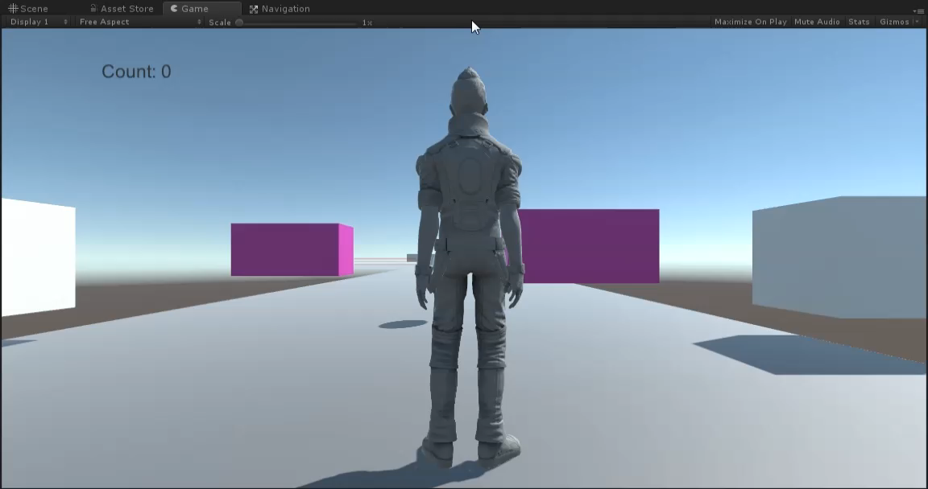
Short Video of Game in action

